Slide 1
The Online Repository
Create a repo online on github.com

Slide 2

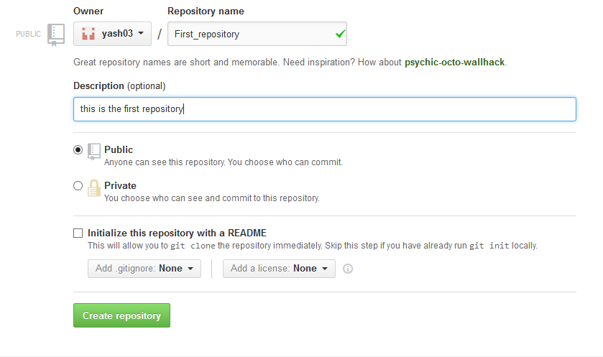
Go to github.com and sign in
Spot the “create new repository” tab
Enter the required values
1.
2.

Slide 3
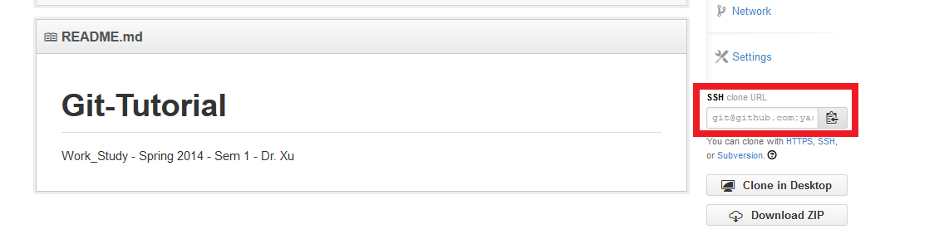

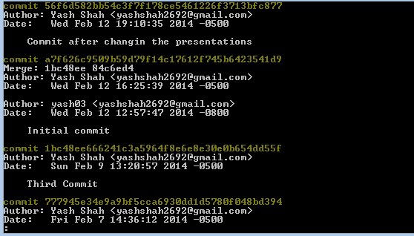
To push your local content (Commits) to online repo, You will need a key to be connected online, It is called a SSH key. You can find it on github.
First you have to ADD the local repository connection, then you can PUSH it.
After setting up the connection, you can push it online.
Check you gitog.
1.
2.
3.
4.

Slide 4
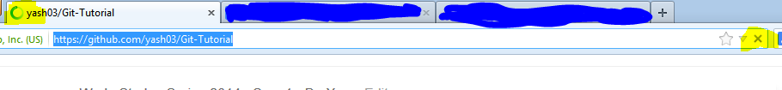
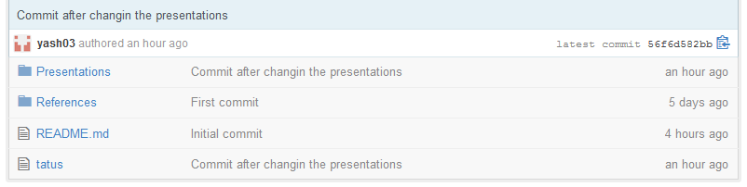
Go to your github account.
Refresh the repo page.
There it is !
1.
2.

